Slide 1
Daily Happiness & Employee Turnover
Is There a Relationship Between Employee Happiness and Job Turnover?
Data Set: https://www.kaggle.com/harriken/employeeturnover
Python, PostgreSQL, sklearn

Slide 2
Setup
For this project, the data set comes from a survey where employees can indicate their happiness levels and write comments and like/dislike comments posted by others. Aim is to explore following questions:
Can we do a prediction about employee churn
Can we identify employees with low motivation, highly probable to churn
The original data set consists of following 4 files, below is the description of fields:
Churn.csv: EmployeeId, CompanyId, Number of time an employee voted, last voting date, whether the employee is still with the company
Votes.csv: EmployeeId, CompanyId, Voting date, Happiness value voted on that day
CommentsInteraction.csv: EmployeeId, CompanyId, CommentId, Comment Liked, Comment Disliked
Comments.csv: EmployeeId, CompanyId, CommentId, Comment Text, Date, Total Likes Received, Total Dislikes Received
Following features were extracted from the given data set and used for machine learning
Feature | Explanation
Numvotes | Total number of times an employee voted
avg_happiness | The average value of happiness votes
likes_received | Total number of likes received against the comments posted by the employee
dislikes_received | Total number of dislikes received against the comments posted by the employee
liked | Total number of comments liked by the employee
Disliked | Total number of comments disliked by the employee
stillexists | If the employee is still with the company (T) or left (F)

Slide 3
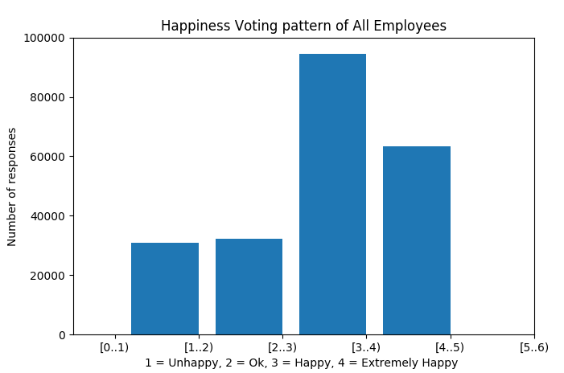
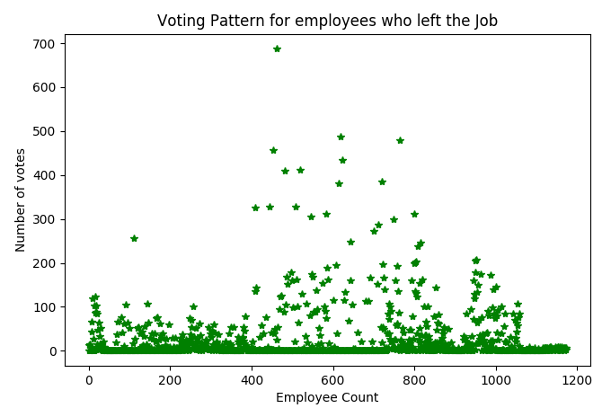
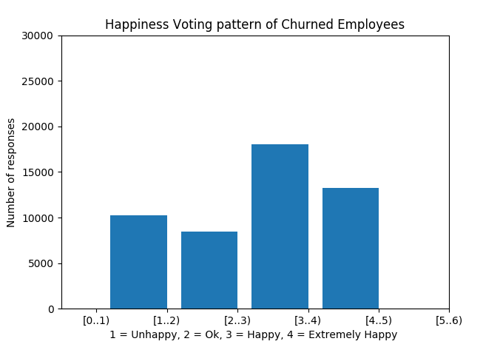
Data Exploration
 | Average value of likes | Average value of dislikes
All employees | 6.8868 | 1.2698
Employees that churned | 8.33 | 3.43

Slide 4
Approach
From the identified feature set we made following subset of features:
feature_list1=['numvotes', 'avg_happiness', 'likes_received', 'dislikes_received', 'liked', 'disliked']
feature_list2=['numvotes', 'likes_received', 'dislikes_received', 'liked', 'disliked']
In feature_list2 we removed the average happiness vote value. Both the features set were used for evaluation in the classification algorithms. Based on the scores we will chose an optimal feature set.
Logistic regression and decision tree classifier were used for classification.
We thus have the evaluate performance outcome of 4 approaches and choose optimum:
1. Logistic regression with feature_list1
2. Logistic regression with feature_list2
3. Decision Tree classification with feature_list1
4. Decision Tree classification with feature_list2

Slide 5
Result
Following are the classification scores per approach defined above:
1. Logistic regression with feature_list1
** employee is still with the company (T) or left (F)
Note: Here precision as well as recall scores are very low for ‘F’ class that means employees who have left so its not a good model for classification.
2. Logistic regression with feature_list2
Note: Here precision is improved but recall is very poor for class ‘F’ so its not a good model for classification.
Decision Tree classification with feature_list1
Note: : Here precision & recall both are significantly improved for class ‘F’ so its a good model for classification.
Decision Tree classification with feature_list2
Note: : Here precision has improved significantly though recall has decreased a bit for class ‘F’ so its also a good model for classification.
 | precision | recall | f1-score
F | 0.72 | 0.11 | 0.19
T | 0.81 | 0.99 | 0.89
Avg | 0.79 | 0.81 | 0.75
 | precision | recall | f1-score
F | 1.00 | 0.03 | 0.06
T | 0.80 | 1.00 | 0.89
avg | 0.84 | 0.80 | 0.72
 | precision | recall | f1-score
F | 0.85 | 0.60 | 0.70
T | 0.90 | 0.97 | 0.94
Avg | 0.89 | 0.90 | 0.89
 | precision | recall | f1-score
F | 0.98 | 0.48 | 0.64
T | 0.88 | 1.00 | 0.94
avg | 0.90 | 0.89 | 0.88

Slide 6
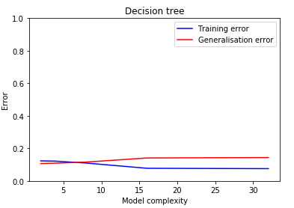
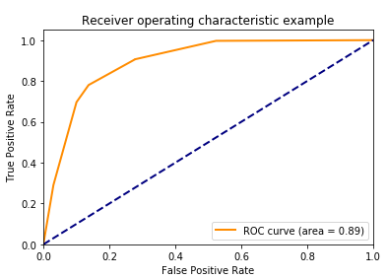

Result
Feature_List2 performs better than list 1 that means average happiness vote value is not a good parameter to determine employee churn.
Decision Tree Classifier works better in this case. As Case#4 has better precision for class ‘F’ that is predicting that churned so we conclude Decision Tree classification with feature_list2 as the optimal mode.
Model evaluation:
We see that the decision Tree with depth <5 gives least values for Generalisation error. The ROC AUS is .89 and the curve shows good performance for true positive rate.
A decision tree classifier with feature set ['numvotes', 'likes_received', 'dislikes_received', 'liked', 'disliked'] and tree depth less than or equal to 5 gives 89% correct prediction about an employee who is going to leave the company.
Low motivation levels: The decision tree classifier gives prediction values for each employee against each class ‘T’ – employee is going to stay , ‘F’ – employee is going to churn. So by evaluating the probability for class ‘F’, if they have high score (& still working in the company) we can identify them as with low motivation and higher probability to churn so management can engage with them about their concerns.

